Slide 1
CAPSTONE PROJECT: ELECTRIC VEHICLE ANALYSIS
BY
Shalini k

Slide 2
Introduction
Background :
The shift towards electric vehicles (EVs) represents a pivotal move in the transportation sector towards sustainability and reduced carbon emissions. Understanding EV usage patterns, charging infrastructure availability, and market trends is crucial for stakeholders in this rapidly evolving industry.
Objective :
This dataset aims to provide concise and actionable insights into the electric vehicle landscape, enabling users to visualize and analyze key metrics such as charging station distribution, EV sales trends, and environmental impact data. The objective is to empower decision-makers to make informed choices and drive the transition towards a more sustainable mobility future using Power BI dashboards.

Slide 3
Problem Statement :
The dashboard should provide real-time insights into key performance indicators (KPIs) related to our s data. This will enable us to make informed decisions, monitor our progress, and identify trends and opportunities for growth.
KPI’s Requirement :
Total Vehicles:
Average Electric Range
Count of Model
Count of Manufactures

Slide 4
Charts Requirements
Total Vehicles by Model Year (From 2010 Onwards)
Total Vehicles by State:
Top 10 Total Vehicles by Make
Total Vehicles by CAFV Eligibility
Top 10 Total Vehicles by Model

Slide 5
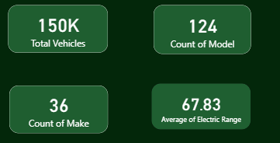
CHARTS OF DASHBOARD
Total Vehicles:
Understand the overall landscape of electric vehicles, encompassing both BEVs and PHEVs, to assess the market's size and growth.
2. Average Electric Range:
Determine the average electric range of the electric vehicles in the dataset to gauge the technological advancements and efficiency of the EVs.

Slide 6
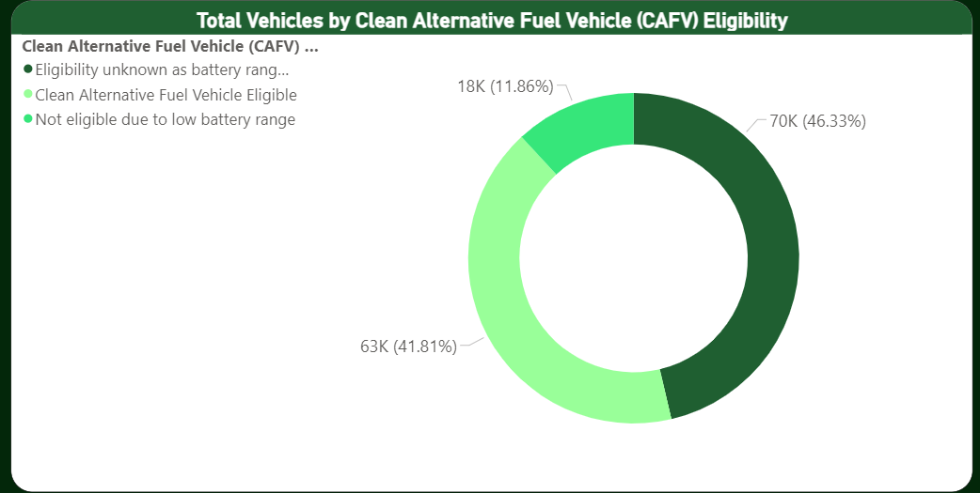
From this donut chart we see that 42% is eligible for Clean Alternative Fuel Vehicle benefits.
Other 46% is eligible without knowing the battery range .
11% is not eligible due its battery range.

Slide 7
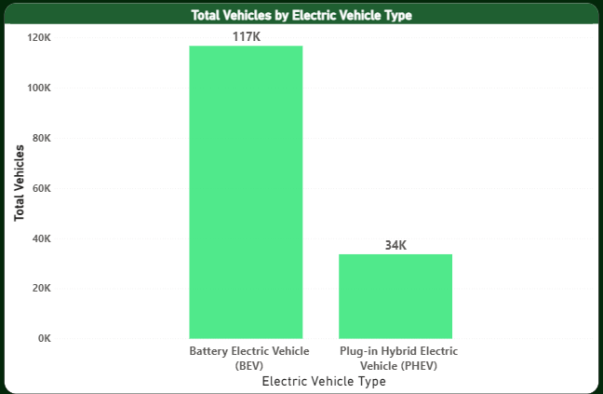
Battery Electric Vehicle (BEV): The 78.1% of the total. BEVs are electric vehicles that run solely on batteries and do not have a gasoline engine.
Plug-in Hybrid Electric Vehicle (PHEV): This category makes up the remaining 21.9% . PHEVs combine an electric motor and battery with a gasoline engine, allowing them to operate in both electric and hybrid modes.

Slide 8
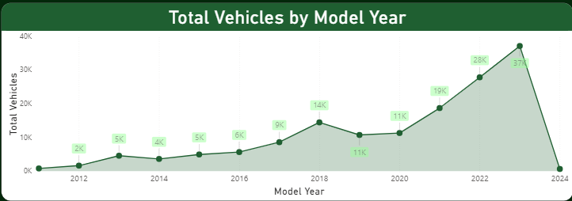
This chart will illustrate the distribution of electric vehicles over the years, starting from 2010.
Here we see that year by year the growth of electric vehicles is increasing.
In the year 2019 and 2020 the growth of electric vehicles constant.

Slide 9


From this shape map we can illustrate that was the dark shaded color represents wastington has the maximum electric vehicle all over the state.
The lite color represents minimum electric vehicle in the state.
The non shaded part represents that no electric vehicles are found.

Slide 10
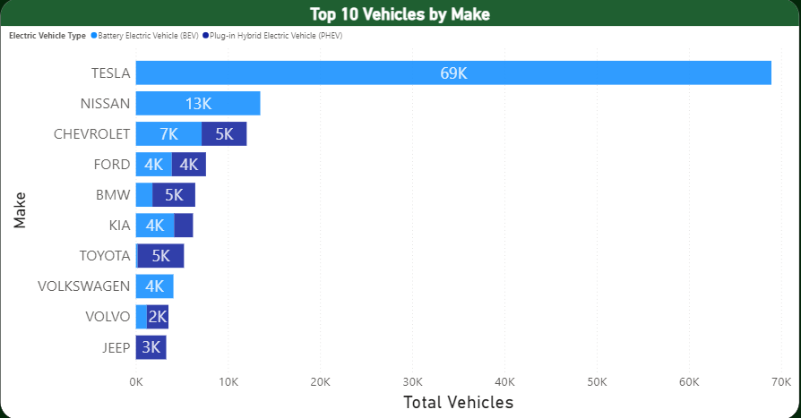
Here bar chart highlight the top 10 electric vehicle manufacturers based on the total number of vehicles.
TESLA company has the highest manufacturing of electric vehicles.
JEEP company has the least manufacturing of electric vehicle.

Slide 11
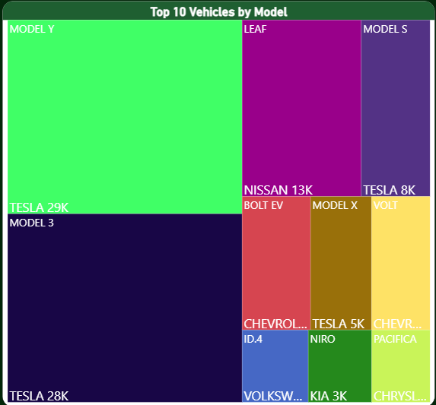
Here tree map highlight the top 10 electric vehicle models based on the total number of vehicles.
The TESLA company has the highest models .

Slide 12
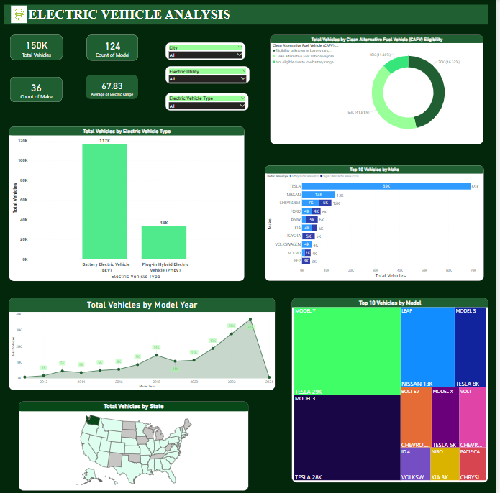
DASHBOARD

Slide 13
CONCLUSION
The Indian EV market is changing rapidly, and the number of EVs on the road is growing rapidly. The majority of EVs in India are two-wheelers and three-wheelers, but the number of four-wheelers is growing rapidly. The top five states for EV sales are Maharashtra, Gujarat, Karnataka, Tamil Nadu, and Uttar Pradesh. The most popular EV brands in India are Ola Electric, Hero Electric, and Ather Energy.

Slide 14


